Slide 1


Notes:
Welcome to

Slide 2
Thames River Heritage Park
Funding Request – Water Taxi Operation
Expense | Description | Unit | Subtotal
Boat Operation | Boat Manager, Captains and Crew, Maintenance and Repairs, Fuel, Insurance, Licenses etc. – 3 boats | $ 50,000 | $ 150,000
Administration | Tour Coordination, Scheduling, Ticket Admin., Bookkeeping, Software, etc. | $ 45,000 | $ 45,000
Promotion | Digital Communications Coordination, Ads, Brochures, etc. | $ 55,000 | $ 55,000
Total Expense |  |  | $ 250,000
Income | Description | Unit | Subtotal
State of CT DOT |  |  | $ 200,000
Sales | Ticket Sales, Charters, Sponsorships |  | $ 50,000
Total Income |  |  | $ 250,000
Notes:
NOTE: Tickets and charter revenue are based on 2022 season which had no rain or storms.

Slide 3
Thames River Heritage Park a State of Connecticut Heritage Park
Sec. 23-10h. Heritage parks: Legislative policy. The General Assembly recognizes that the cities in the state have a rich historical and cultural heritage, that many of the cities are in need of economic revitalization and that preservation and interpretation of such heritage can foster revitalization by encouraging private sector investment and tourism. Therefore, the General Assembly declares that it is the policy of the state to develop new recreational opportunities in conjunction with the preservation and interpretation of such heritage through the designation of a system of heritage parks so that the quality of life for Connecticut residents may be improved.

Slide 4

Thames River Heritage Park a State of Connecticut Heritage Park
July 1990
CT Department of Environmental Protection
designates
Thames Maritime Heritage Park
(predecessor of Thames River Heritage Park)
as a State park.

Slide 5
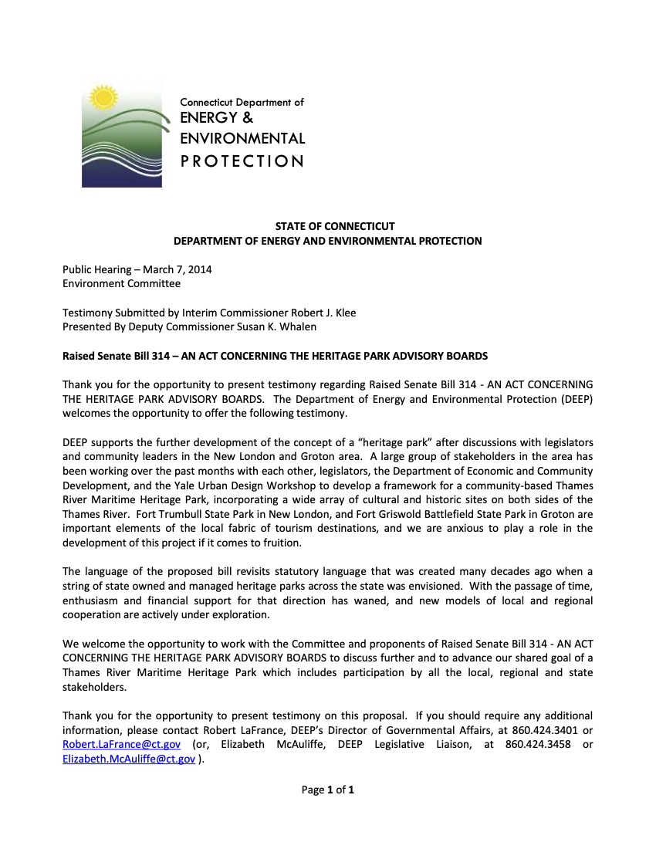
Thames River Heritage Park a State of Connecticut Heritage Park
Raised Senate Bill No. 314 AN ACT CONCERNING THE HERITAGE PARK ADVISORY BOARDS
Public Hearing – March 7, 2014 Environment Committee
Testimony Submitted by Interim Commissioner Robert J. Klee
Presented By Deputy Commissioner Susan K. Whalen
DEEP supports the further development of the concept of a “heritage park” ... and the Yale Urban Design Workshop to develop a framework for a community-based Thames River Maritime Heritage Park … and we are anxious to play a role in the development of this project...

Slide 6
Thames River Heritage Park a State of Connecticut Heritage Park
November 11, 2014
The Day - Four more groups join push for Thames River Heritage Park
"The Thames River Heritage Park is not a mere plan to increase tourism to the southeast region of Connecticut but a framework for regional transportation and economic development that would incorporate cultural, educational and environmental initiatives."
John Riccio Jr.
Chairman, Newington-based Maritime Commission

Slide 7
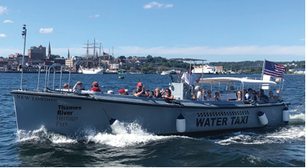
Thames River Heritage Park a State of Connecticut Heritage Park
Raised Bill No. 345 AN ACT CONCERNING THE WATER TAXI AT THE HERITAGE PARK IN THE TOWNS OF GROTON AND NEW LONDON.
January Session 2015
Be it enacted by the Senate and House of Representatives in General Assembly convened:
Section 1. (Effective July 1, 2015) The sum of one hundred thousand dollars is appropriated to the city of Groton, from the General Fund, for the fiscal year ending June 30, 2016, for the purpose of funding the water taxi connecting the cities of Groton and New London at the Thames River Heritage Park.

Slide 8
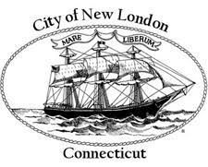


Thames River Heritage Park
a State of Connecticut Heritage Park
City of New London
City of Groton
Town of Groton

Slide 9

Thames River Heritage Park a State of Connecticut Heritage Park
Mission
Connect
Support
Promote
Sustain

Slide 11


Slide 12



Slide 13



Slide 14
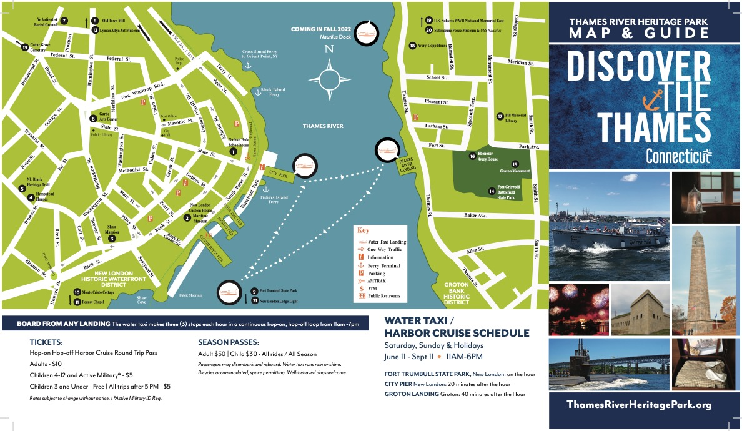

Slide 15
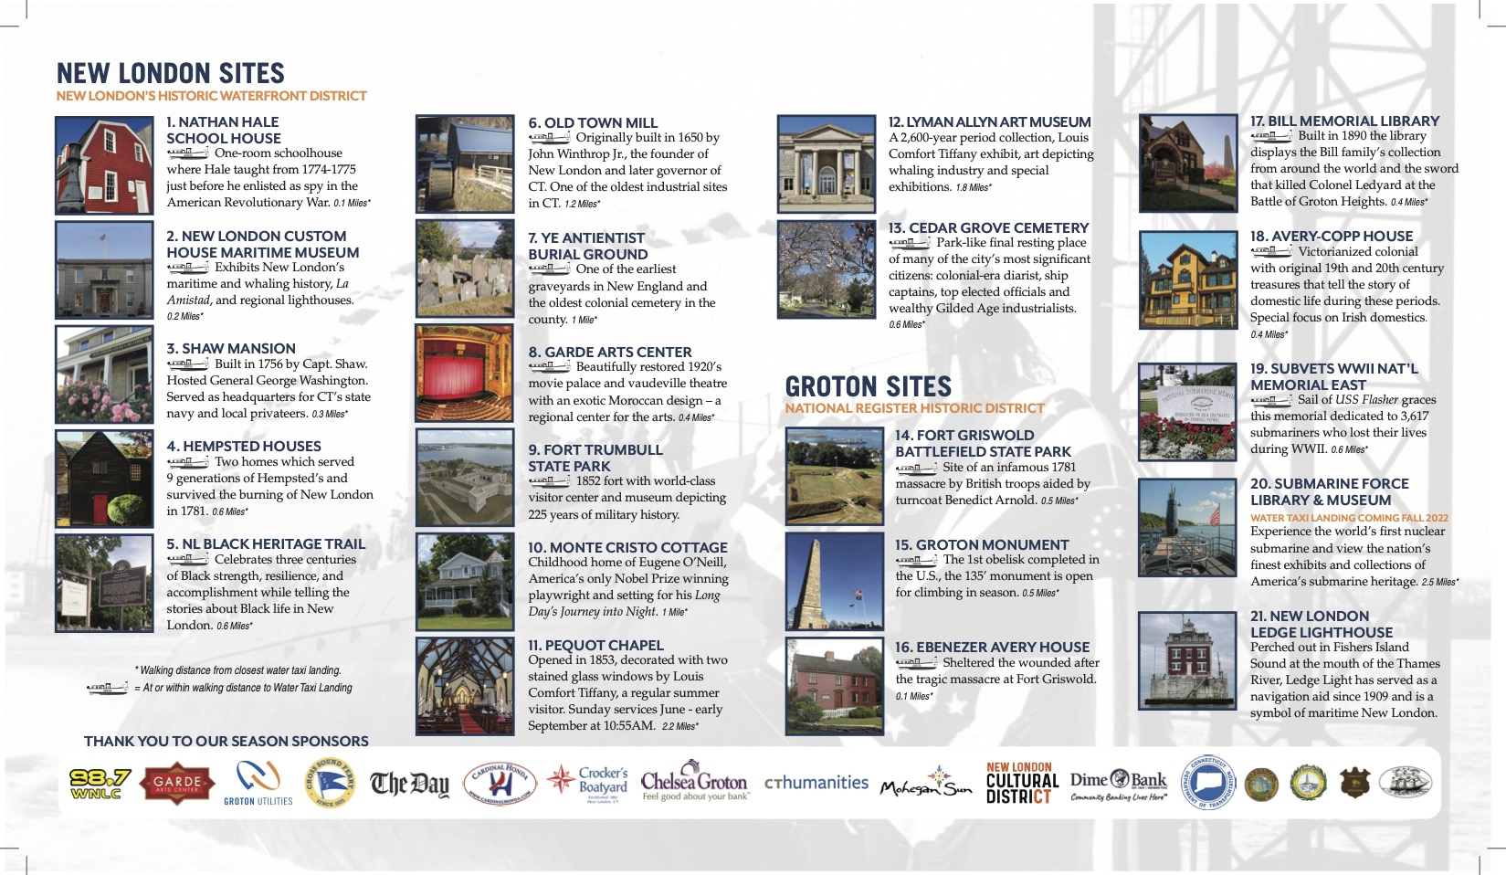

Slide 16
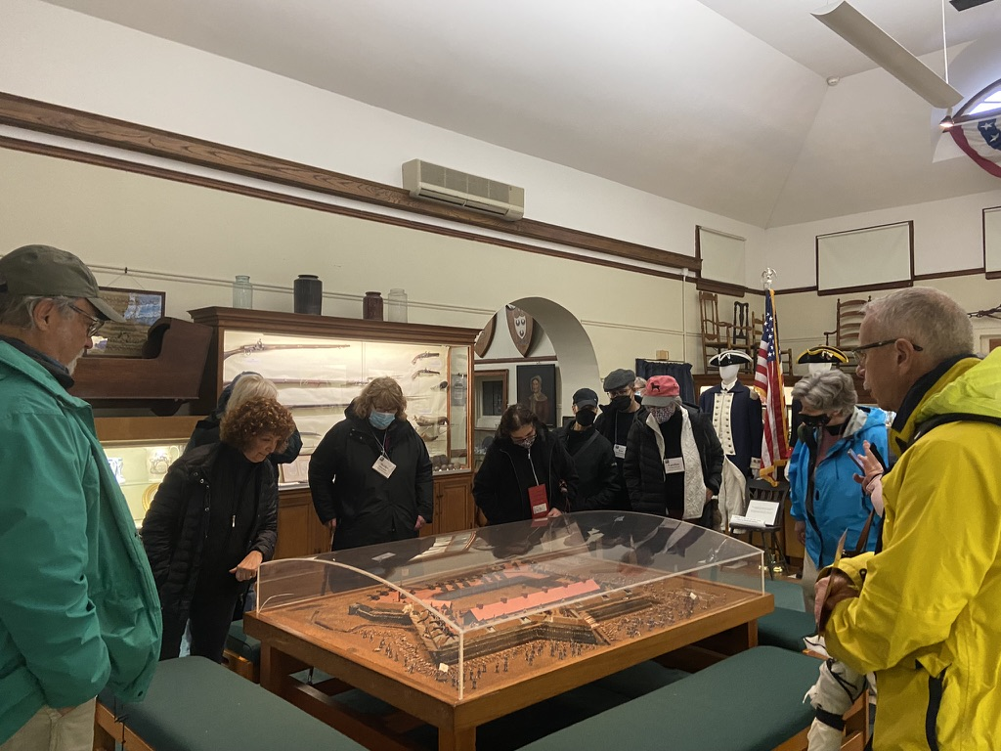
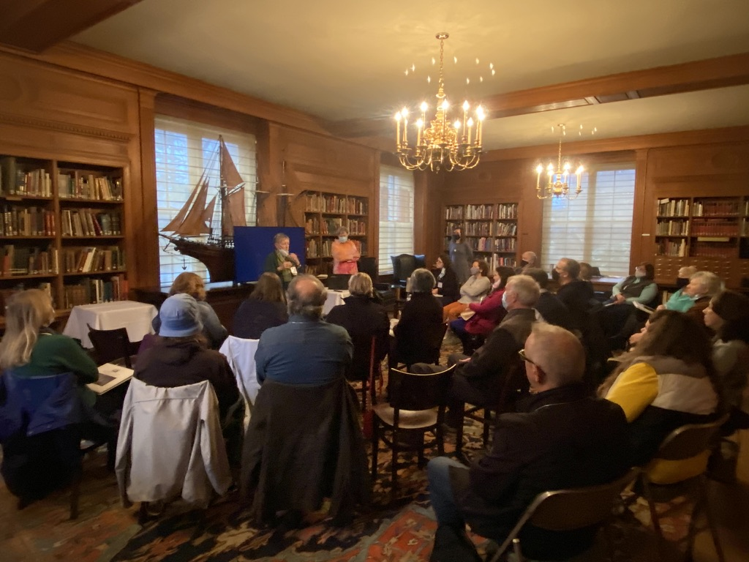
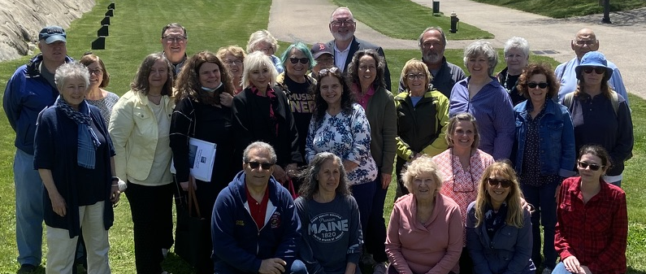
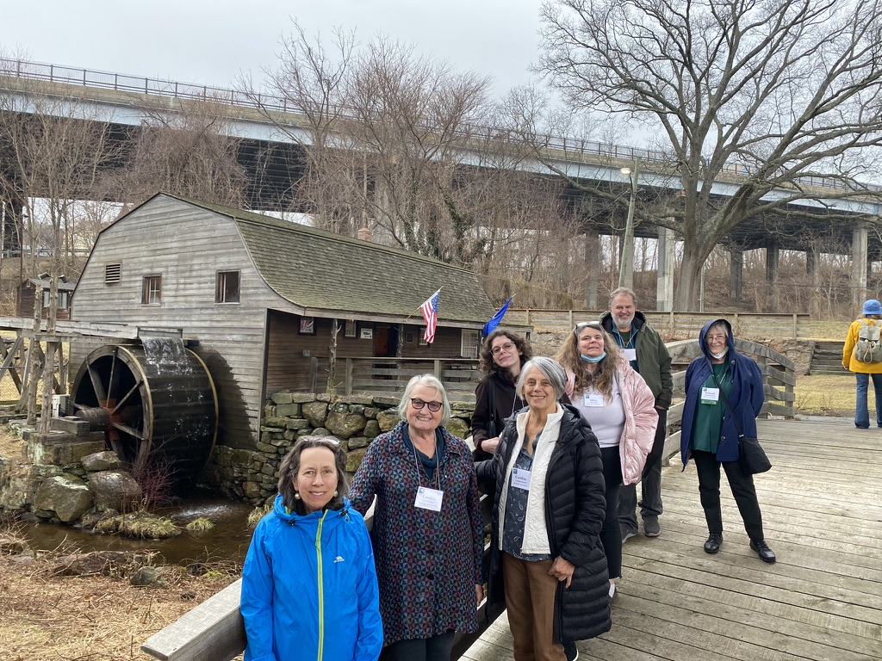
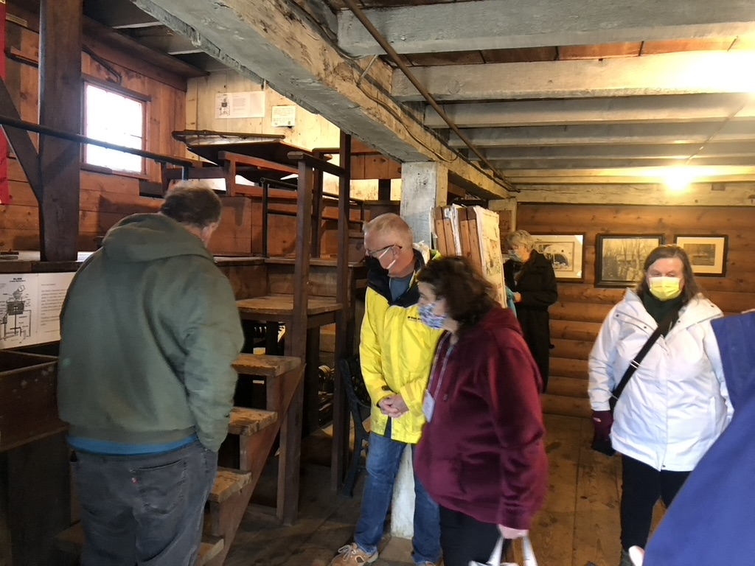

Slide 17
Stories from the Park Lecture Series
In partnership with Lyman Allyn Art Museum
Morton Plant: Gilded Age Gossip, Giving and the (income) Gap
Gail MacDonald, Journalist and Author
Wednesday, 1/4/2023 | 6:00 PM – 8:00 PM
Love and Brutality: The Mysterious Saga of Gallows Road.
Lisa Brownell, Author
Wednesday, 1/25/23 | 6:00 PM – 8:30 PM
For Adam’s Sake: A Family Saga in Colonial New England
Allegra DiBonaventura, Author
Wednesday, 2/15/23 | 6:00 PM – 8:30 PM
Homegrown Terror: Benedict Arnold and the Burning of New London
by Eric Lehman, Author
Wednesday, 3/8/23 | 6:00 PM – 8:00 PM
Spooky Trails and Tall Tales Connecticut: Hiking the State’s Legends, Hauntings, and History
Stephen Gencarella, Author
Wednesday, 3/29/2023 | 6:00 PM – 8:00 PM
Earth and Sky: Nature Meditations in Word and Watercolor
Judy Benson, Journalist and Author
Roxanne Steed, Illustrator
Wednesday, 4/19/2023 | 6:00 PM – 8:00 PM
Notes:
Partner to add programs that encourage visitation to the sites and promote history of region.
Coordinate w municipalities economic development and cultural district commission
Offer fundraising opportunities – ie., boat tours, cruises for partners
Quarterly partner meetings to increase collaboration
Program committee
Grants to support programs like DA, lectures, etc.
Monthly / weekly eblasts to promote partners and events on the Thames

Slide 18
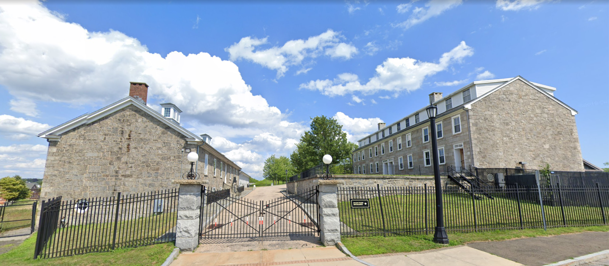
Thames River Heritage Park
a State of Connecticut Heritage Park
Office / Visitor’s Center

Slide 19
Thames River Heritage Park
Funding Request – Water Taxi Operation
Expense | Description | Unit | Subtotal
Boat Operation | Boat Manager, Captains and Crew, Maintenance and Repairs, Fuel, Insurance, Licenses etc. – 3 boats | $ 50,000 | $ 150,000
Administration | Tour Coordination, Scheduling, Ticket Admin., Bookkeeping, Software, etc. | $ 45,000 | $ 45,000
Promotion | Digital Communications Coordination, Ads, Brochures, etc. | $ 55,000 | $ 55,000
Total Expense |  |  | $ 250,000
Income | Description | Unit | Subtotal
State of CT DOT |  |  | $ 200,000
Sales | Ticket Sales, Charters, Sponsorships |  | $ 50,000
Total Income |  |  | $ 250,000
Notes:
NOTE: Tickets and charter revenue are based on 2022 season which had no rain or storms.
Not included in the above are the general admin and costs for additional programs – Docent Academy, Lecture Series, Partner Coordination, Weekly/Monthly Newsletter Eblasts (events), etc.

Slide 20
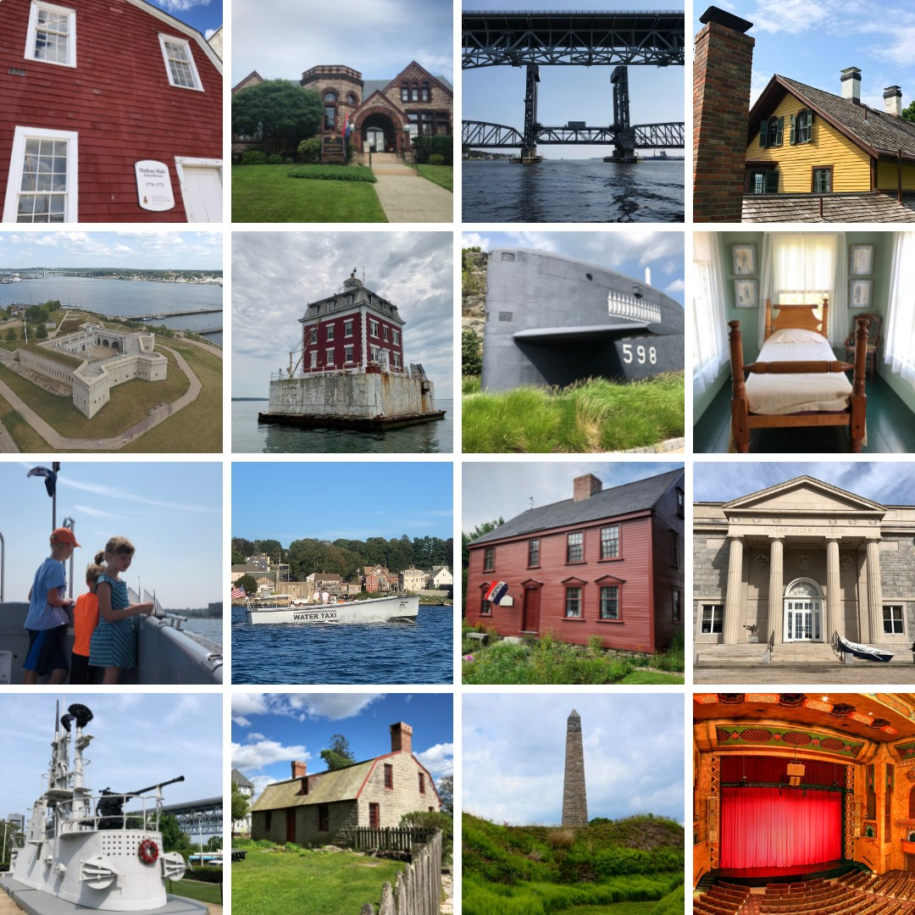

Thank you!

